Slide 1
Scientific Research in Information Systems
Chapter 6
Writing IS Research Articles
JAN RECKER

Slide 2
Overview
Writing IS Research Articles
Strategising
Structure and Contents
Handling Reviews and Revisions
Further Reading
Notes:
Sub-chapters
Strategising: The Publishing Process, Key Publishing Decisions, Co-authorship, The Pre-submission Lifecycle
Structure and Contents: Introduction, Background, Research Model, Research Method, Results, Discussion, Implications, Conclusions, Abstract
Handling Reviews and Revisions: Understanding Reviews, Managing Revisions

Slide 3
Writing IS Research Articles
Publication is an essential scholarly activity because it informs academic and other communities about lines of investigation, (and their outcomes) related to relevant phenomenon being studied.
The purpose of an academic is to produce and disseminate research results.
Your publications advertise your skills, areas of interest, as well as your expertise.
The number (“how many”) and quality (“how good”) of your publications will determine your success in research.
Publishing is about reporting results.
It requires a mindset of telling “what you have found” more so than reporting “what you have done”.
Writing a good research article is a very challenging task, consumes a great deal of time and dedication
“Publish or perish!”
Notes:
“Publish or perish!” (Anne Harzing)

Slide 4
Strategising
The Publishing Process
Key Publishing Decisions
Co-authorship
The Pre-submission Lifecycle

Slide 5
Strategising
Writing should be considered a strategic activity.
50% of papers are never cited.
Citations are an indication of how many scholars have read an article and used it in their own line of argumentation and thus refer to the paper in their own papers.
The most important rule when strategising about publishing is that good papers build on good research
You can easily waste good research by not writing about it well enough.
Notes:
50% of papers are never cited (Amanda Spink)

Slide 6
The Publishing Process
Scholarly publications, typically contributions in books, journals, or conference proceedings, only “count” as publications if they are peer-reviewed.
Author(s) submit a proposed publication
An editor of that outlet (say, book or journal) sends advance copies of an author’s work to researchers who are experts in the field (known as “referees” or “reviewers) normally by e-mail or through a web-based manuscript processing system.
These referees each return an evaluation of the work to the editor, noting weaknesses or problems along with suggestions for improvement.
The editor, usually familiar with the field of the manuscript although typically not in as much depth as the specialist referees, then evaluates the referees’ comments, adds their own opinion of the manuscript, and the context of the scope of the journal or level of the book and readership
Editor passes a decision back to the author(s), usually with the referees’ comments

Slide 7
The Publishing Process (Cont.)
Scholarly elite journals relevant to information systems research (Top-Six Basket of Journals)
Management Information Systems Quarterly
Information Systems Research
Journal of the Association for Information Systems
European Journal of Information Systems
Journal of Management Information Systems
Information Systems Journal

Slide 8
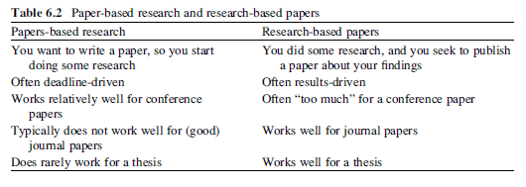
Key Publishing Decisions
Important things to select a suitable target outlet
The academic publishing process is a “one shot option”.
Once you published a result, you can’t publish it again.
The academic publishing process is an open publishing process.
Once you publish an idea, it is out there with your name attached to it.
You need to consider that research writing is a skill that is typically not part of the curriculum for your doctoral degree.
Write early and to write often.
Writing papers is the best practice for writing a good thesis.
Distinguish ‘research-based papers’ from ‘papers-based research’.
Notes:
When selecting a suitable target outlet for an academic paper, you need to keep a couple of important things in mind:

Slide 9
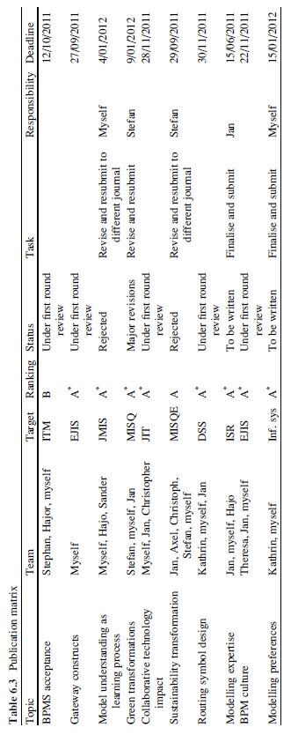
Key Publishing Decisions (Cont.)
Use a publication matrix that maintains an overview of your publication work in progress.
Notes:
Table 6.3 gives an example. Such matrices assist you in planning your research and publication program and in monitoring progress, tasks, and responsibilities.

Slide 10
Co-authorship
Collaboration is a key element of scientific work and thus, co-authored papers are the norm rather than the exception in scholarly publications.
Collaboration might mean
working together with your supervisor
Collaborating with other (junior or senior) academics on topics of mutual interest.
Co-authoring papers is a preferred strategy for several reasons:
Working only by yourself requires you not only to do all the work yourself but also that you need to be strong in all aspects of the research lifecycle.
You will also not be able to progress on as many projects and papers concurrently as colleagues that collaborate
Important aspects of collaboration
Complementarity of skills
Alignment of working styles
Notes:
With complementarity I refer to synergy benefits that stem from working with people that provide strengths complementary and not redundant to your own. In turn, if you are an expert in some area (say, quantitative data analyses), this might also make you a perfect collaborator for someone with a need for such expertise. Regarding alignment, over time I have come to realise that my successful collaboration were those with people with similar work styles (I would call my style independent and document-centric) and who I enjoy working and being with.

Slide 11
The Pre-submission Lifecycle
One of the most important decisions in the presubmission stage is the target outlet.
Points to consider in making target outlet decisions include:
What journals did you read in doing the research?
How well do you know the outlet?
Did you follow the guidelines?
What is the audience and pool of reviewers?
How low should you go?

Slide 12
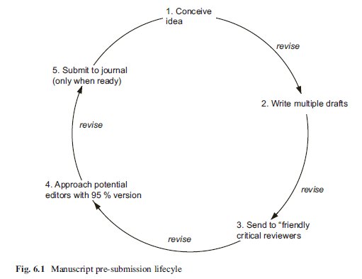
The Pre-submission Lifecycle
Notes:
Having identified a suitable target, the next phase consists of carefully threading through the pre-submission lifecycle shown in Fig. 6.1.

Slide 13
Structure and Contents
Introduction
Background
Research Model
Research Method
Results
Discussion
Implications
Conclusions
Abstract

Slide 14
Structure and Contents
The type of structure your manuscript requires will vary depending on the nature of the field you are publishing in.
Still, the general writing process should look as follows:
Develop a structure.
Revise the structure.
Start populating the sections.
Revise the sections.
Revise the paper/thesis.
Put it in a drawer, take it out, read it again, revise it again (remember?).
Pre-submit to a friendly reviewer, pre-submit to an editor, and finally actually submit the paper.

Slide 15
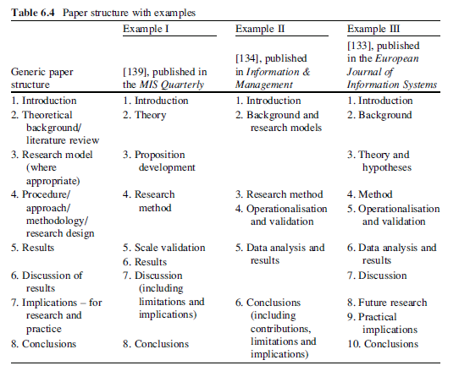
Structure and Contents
Notes:
While papers vary somewhat across methodologies and fields (for example, some fields may use different headings or sections), you will find that most ‘regular’
research papers in information systems research adhere to the following structure shown in Table 6.4.

Slide 16
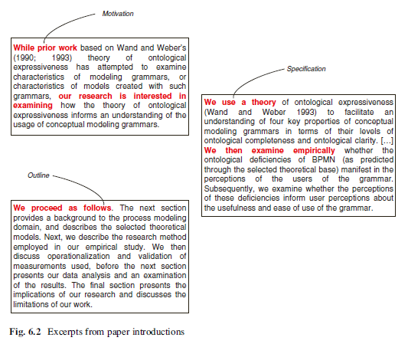
Introduction
It should contain three parts, and three parts only:
Motivation: What is your problem, and why is it a problem?
Specification: What is your specific research question/research outcome? What is your research approach (in very general terms)?
Outline: How will the paper tell us about what you did?

Slide 17
Background
It must discuss followings:
Relevant theories that are the foundation for your study
Relevant concepts or terms that you use
Relevant previous methods/algorithms/findings/arguments that your work builds on
A good piece of advice is to concentrate only on literature
That led you to investigate the problem,
That puts your findings into context, and/or
That sets up your argument.
Background section is not:
A recap of all other works in the area,
Criticism of all other works in the area, or
A collection of term definitions.

Slide 18
Background (Cont.)
In writing a background section, follow these pieces of advice:
Organise the section according to topics
Discuss, don’t just list related work
Don’t exaggerate differences and instead explain how your work complements others’ work.
Don’t be afraid if your work contradicts previous work.
Highlight areas in which your work builds on others.
Most importantly, keep it concise and precise.

Slide 19
Research Model
The section should be organised by first providing an overview of the conceptual or research model that is being developed.
The central part of this section is the development of hypotheses.
A hypothesis must contain a justified theoretical argument for why you expect a certain phenomenon to occur (or not).
Connect your hypotheses to existing research.
Keep your hypotheses simple but precise
They should specify two (or more) key constructs and the relationship between them.
Identify dependent and independent variables and the direction of expected relationships

Slide 20
Research Method
The objective of the section is to describe the research carried out in such a way that anyone should be able to repeat your work based on your description – to meet the requirement of replicability.
Key elements in this section pertain to the selection and justification of a research strategy, the identification of materials, case sites, scope of survey, appropriate samples, participant selection and all other decisions pertinent to the research design.
Other key elements include the detailed and precise description of the analytical measurements or data collection techniques employed as well as the data analysis techniques in use – both in qualitative and quantitative studies.

Slide 21
Results
It only contains a description of findings.
It should contain just factual result reporting (typically written in past tense), including appropriate statistical tests or other analyses – but no discussion or interpretation of the findings.
It tells the reader “this is what we found” but not “this is what that means”.
Writing, statistics, and graphs should be presented as simply as possible.
Do not present irrelevant data to which the discussion that ensues will not refer.

Slide 22
Discussions
It is where we make sense of the results, by exploring what they indicate, how they relate to our theoretical expectations, and how they inform us.
A discussion section should begin by summarising the main findings.
Then, interpret the findings:
What do the results actually mean?
Why did you get the results that you obtained?
What did they tell you in light of the theory you set out to evaluate?
Focus on three key activities:
explaining the results
abstracting the results
theorising about the results
A good discussion section also contains reflection.
Notes:
Reflection means relating the findings back to the initial problem the paper set out to do. This should come early in a discussion section.

Slide 23
Implications
Good journals demand specific and explicit implications for ongoing research and practice.
Implications for practice
Detail how the study findings change or otherwise impact the way that important stakeholders work in actual practice.
Implications for research
Is a mere description of how the research presented at the conference will be continued after the presentation, to give an indication as to the type of findings that can be expected in the future.
Journals should detail what we have found through execution of the study reported that can guide future studies or other scholars
A new measurement instrument that was developed for the study and is now available to other researchers.
A new theory that was developed and is now awaiting further exploration, application, or evaluation.
Could relate to potential extensions of the study that might explore, for example, important boundary conditions of a theory being developed, or the investigation of some inconsistencies uncovered in collected data.

Slide 24
Conclusions
The conclusions section provides the closing frame to a paper.
This section is short!
It recaps very briefly the key contributions of the paper, without going into detail.
It provides a reflection about the research presented in the paper, without introducing new material or findings.
In this section:
Identify the key findings of your paper and relate them back to the introduction.
Highlight the specific significance of the work and how it provides a way forward for academia and practice
Conclusions section encapsulates the principles of summary, recap, and reflection.

Slide 25
Abstract
somewhere between 100 and 300 words long – that serves as an informative summary of the paper.
is used to entice people to read the full paper but also to summarise the main insights.
You must make your abstract informative.
More people will read the abstract than any other part of the paper.
You should include in the abstract:
A statement of the problem being addressed,
A statement of the approach/methods,
A synopsis of the results,
Your key interpretations of the results, and
The major implications of the results and conclusions.

Slide 26
Handling Reviews and Revisions
Understanding Reviews
Managing Revisions

Slide 27
Understanding Reviews
Peer review
Is a very important process in any academic profession.
Ensures that certain quality standards are met, and that the quality of research and publication work being done in the profession is of a high standard.
The outcomes of the review process can be generally be classified into five types:
Reject
Revise and resubmit
Major revisions required
Minor revisions required
Acceptance or conditional acceptance
Notes:
1. Reject: Your manuscript is denied publication. The outlet will not consider this manuscript or any reworked version of it. This is obviously the most disappointing outcome – and a final one at that.
2. Revise and resubmit. The manuscript is denied publication, but the editors and reviewers feel that a significantly reworked manuscript (which basically means,
scrap the manuscript and start writing all over again) may be submitted to the journal again as a new submission. This resubmission is most often handled by a
new editor and a fresh set of reviewers.
3. Major revisions required. The editors and reviewers see potential in the research conducted, however, the research as presented in the manuscript cannot
be published as is, and major revisions are required. These revisions can relate to writing (introduction, motivation, results presentation, discussion) or also to the
research (different analysis, collection of additional data, (re-) consideration of theory).
4. Minor revisions required: The editors and reviewers feel that the manuscript is quite strong already but have some comments, issues, and suggestions for further
improving the manuscript. Typically, a manuscript is well underway towards publication with such a review outcome.
5. Acceptance or conditional acceptance: This is good news, meaning that the editor decides that a paper can be published as-is, or with very minor changes
that do not require further review.

Slide 28
Managing Revisions
Strategies for managing revisions:
Put the review aside for a while
Read the reviews
Tabularise the reviews
Revise the paper
Write a response letter

Slide 29
Further Reading
Venkatesh, V.: Road to Success: A Guide for Doctoral Students and Junior Faculty Members in the Behavioral and Social Sciences. Dog Ear Publishing, Indianapolis (2011)
Wohlin, Wilkinson, A.M.: The Scientist’s Handbook for Writing Papers and Dissertations. Prentice Hall, Englewood Cliffs (1991)
Lagendijk, A.: Survival Guide for Scientists: Writing – Presentation – Email, 3rd edn. Amsterdam University Press, Amsterdam (2008)

Slide 30
Thank You
☺

